Slide 1
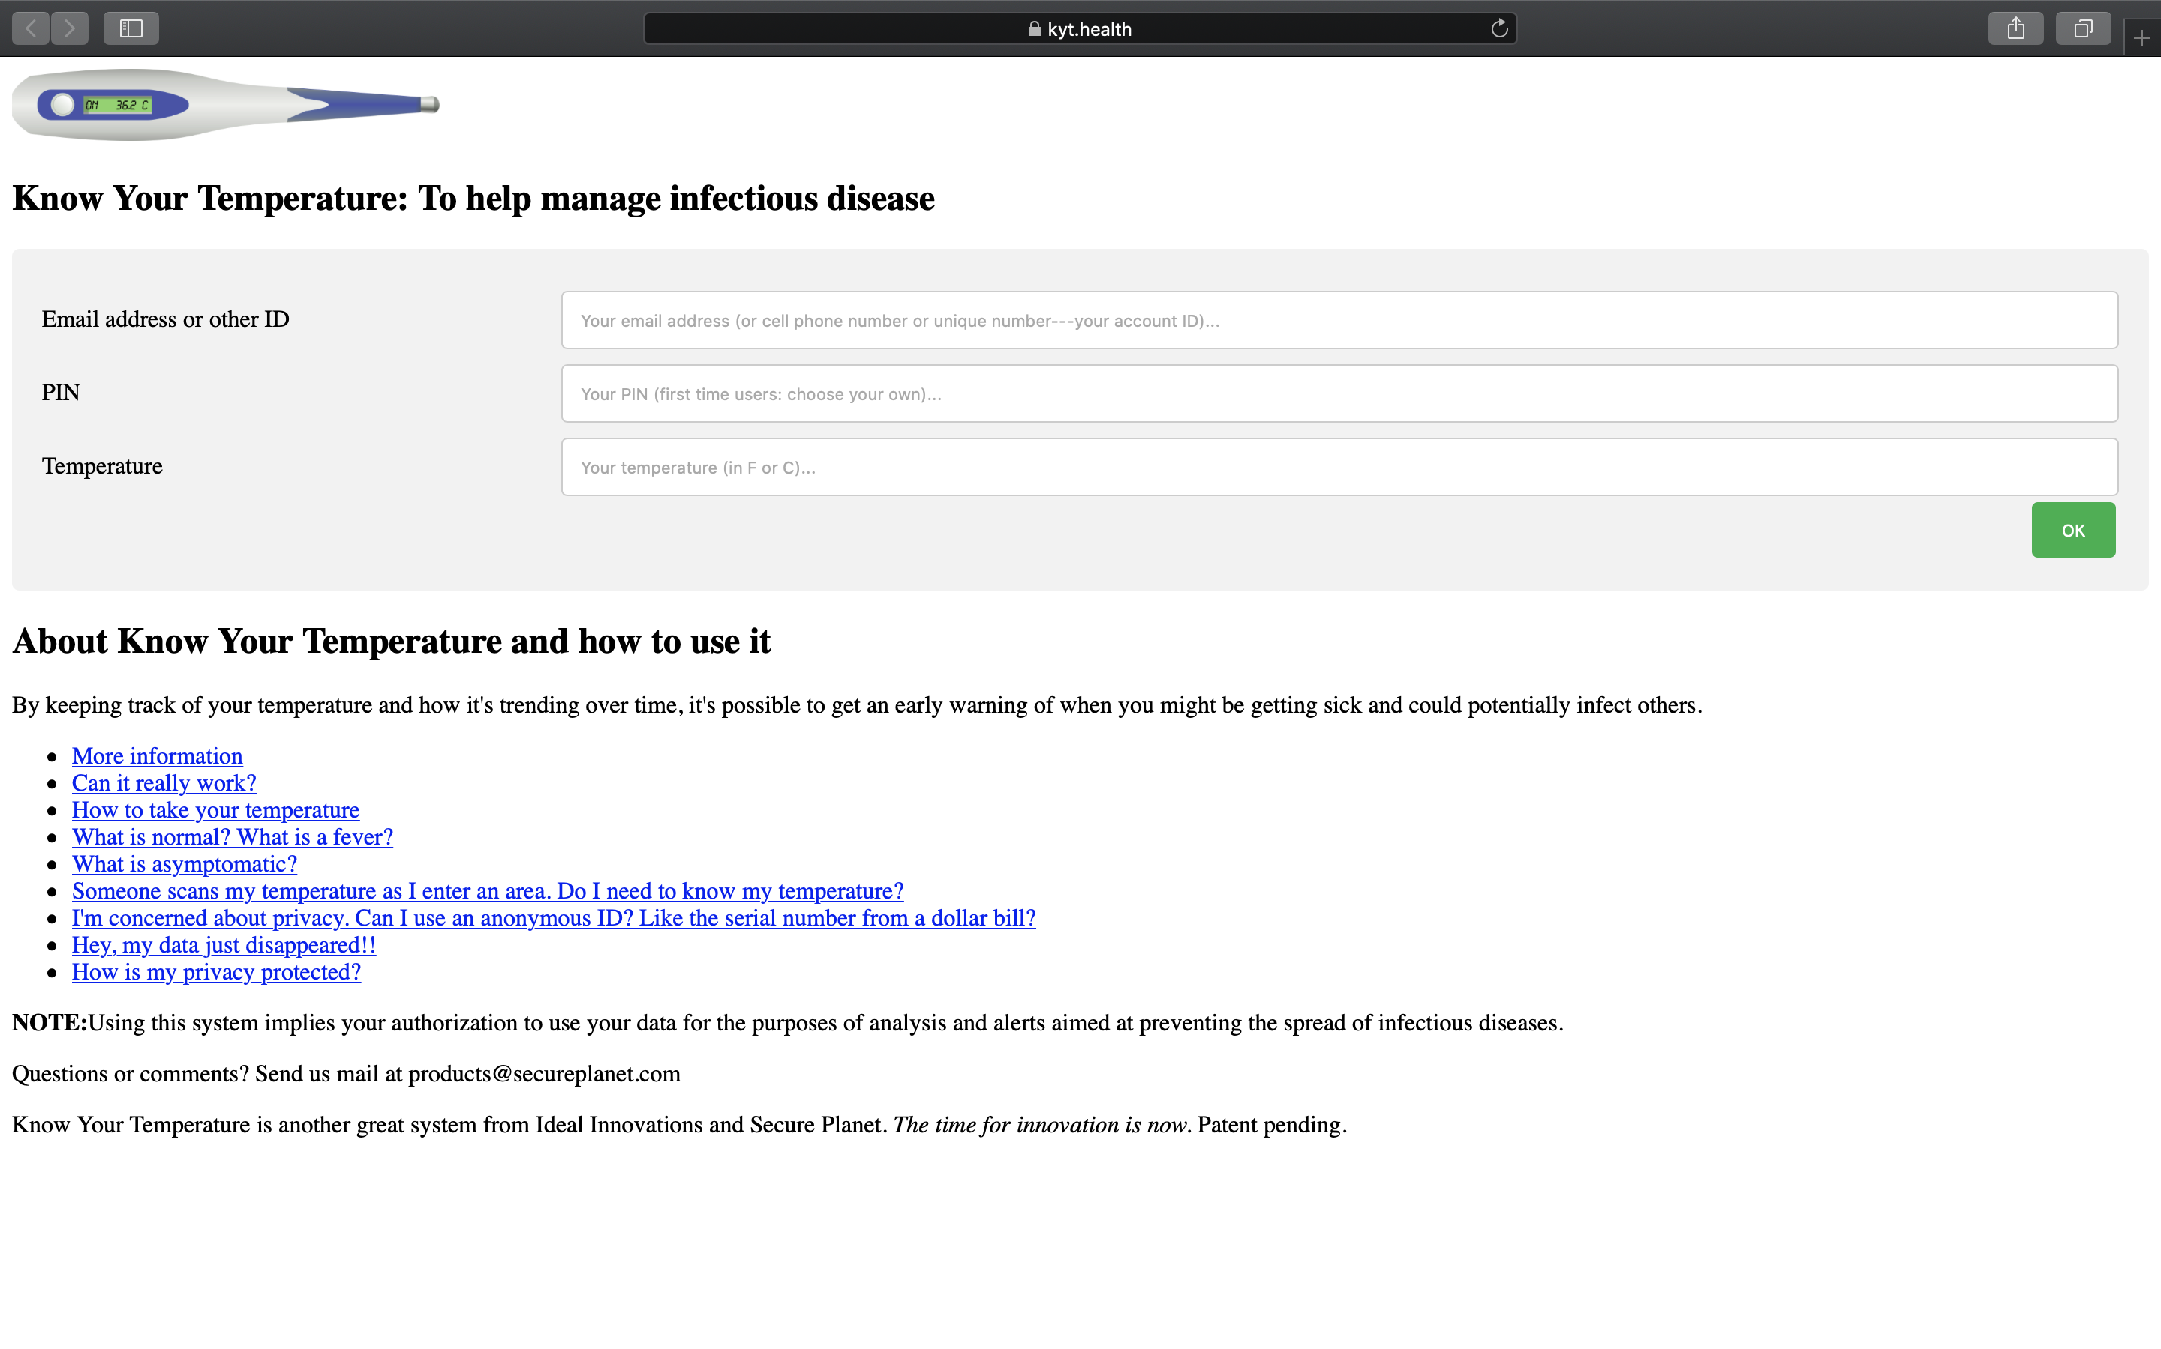
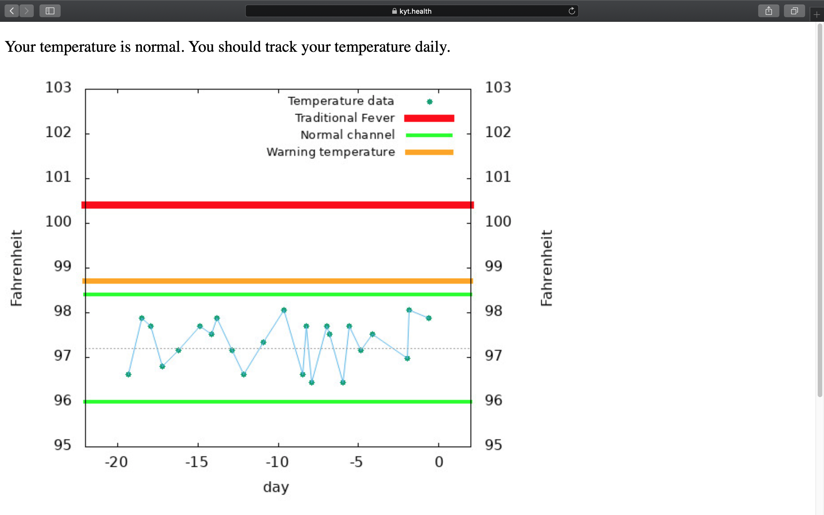
Personal Warning Temperature (PWT) System
2 Times a Day
Personal Warning Temperature
After 5 Days
Bob Kocher
CEO, I-3/ Secure Planet
bob@idealinnovations.com
(703) 969-5765
Doug Dyer, PhD
Chief Scientist
doug.dyer@secureplanet.com
(703) 964-7452
Secure Planet/I-3 Patents Pending

Slide 2
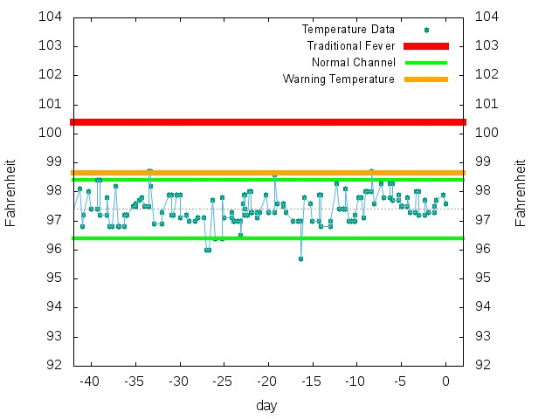
“Know Your Personal Warning Temperature”
A typical User that has been in the program over 40 days
Personalized Warning
Temperature
98.8F
Bob Kocher
CEO, I-3/ Secure Planet
bob@idealinnovations.com
(703) 969-5765
Doug Dyer, PhD
Chief Scientist
doug.dyer@secureplanet.com
(703) 964-7452
Secure Planet/I-3 Patents Pending

Slide 3
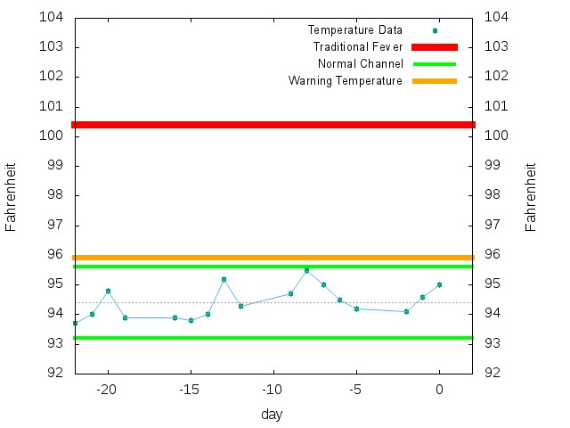
“Know Your Personal Warning Temperature”
Government’s
Fever Standard
100.4F
Generic
Fever
Zone
Personalized Warning
Temperature
95.8F
Personalized
Warning
Zone
Personalized
Temperature
Channel
Wednesday 5PM:
Contact
Exposed to COVID
Bob Kocher
CEO, I-3/ Secure Planet
bob@idealinnovations.com
(703) 969-5765
Doug Dyer, PhD
Chief Scientist
doug.dyer@secureplanet.com
(703) 964-7452
* Temperature Device: NUBEE, Oral Collection, Consistent device and testing standard.
Secure Planet/I-3 Patents Pending

Slide 4
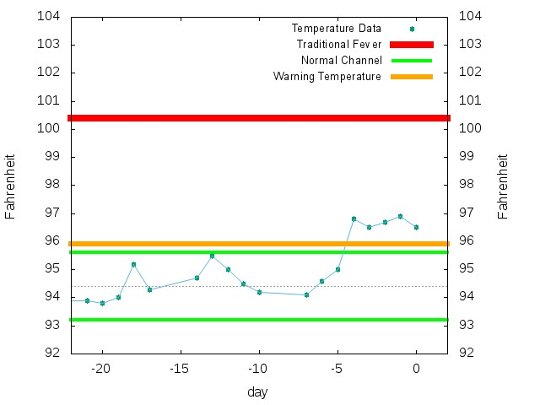
Real Life Case Early Detection COVID-19
Within 17 Hours of Contact
Personalized Warning
Temperature
95.8F
Friday
Test Positive
for COVID
but qualifies as
“Asymptomatic”
because he
does not have a
“Fever”
Bob Kocher
CEO, I-3/ Secure Planet
bob@idealinnovations.com
(703) 969-5765
Doug Dyer, PhD
Chief Scientist
doug.dyer@secureplanet.com
(703) 964-7452
Secure Planet/I-3 Patents Pending

Slide 5
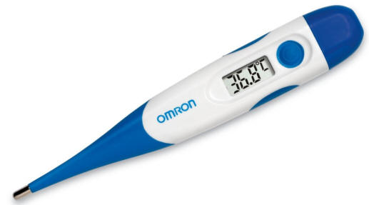
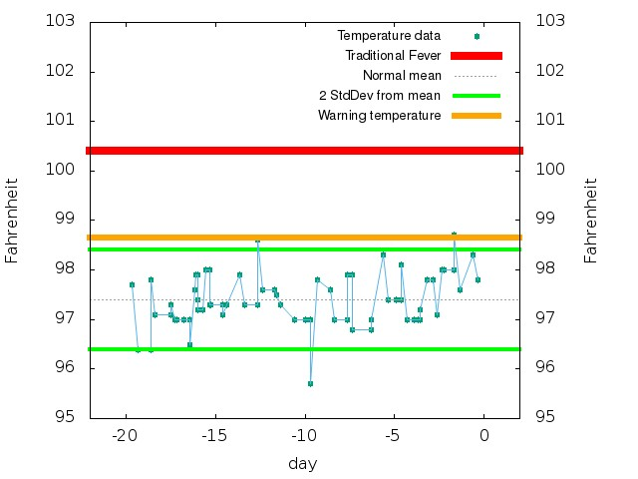
Personal Warning Temperature (PWT) is a Game Changer with COVID-19
In Private
Protect students/ faculty in school/ universities
Businesses and employees returning to work
Government employees and agencies
Sporting events and other entertainment
Conferences and conventions
Oral Thermometer for
personal daily measurements
READY TODAY
Can deliver the system today
Can be deployed on a large scale in less than two weeks
Check yourself every morning
Check before traveling or social gatherings
Bob Kocher
CEO, I-3/ Secure Planet
bob@idealinnovations.com
(703) 969-5765
Doug Dyer, PhD
Chief Scientist
doug.dyer@secureplanet.com
(703) 964-7452
Secure Planet/I-3 Patents Pending

